Slide 1
ParaMeter: A profiling tool for amorphous data-parallel programs
Donald Nguyen
University of Texas at Austin

Slide 2
“Available Parallelism”
How many active nodes can be processed in parallel over time
Profile the algorithm, not the system
Disregard communication/synchronization costs, runtime overheads and locality
Rough upper bound on parallelism
Expose common high-level structure between algorithms

Slide 3
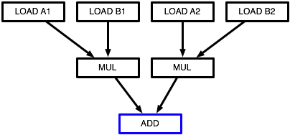
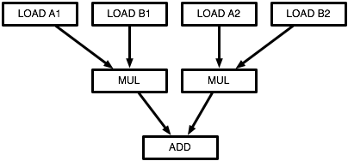
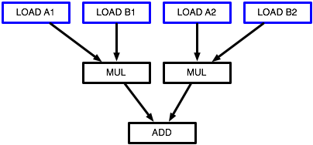
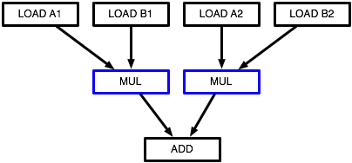
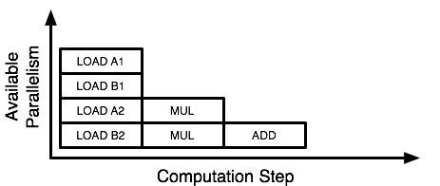
Measuring Parallelism
Represent program as DAG
Nodes: operations
Edges: dependencies
Execution strategy
Operations take unit time
Execute greedily
Profile of #operations executed each step
Cannot build DAG in general for amorphous data-parallel programs
?

Slide 4
Outline
Example: spanning tree
Demo of ParaMeter
Computing parallelism profiles
Algorithm classification

Slide 5
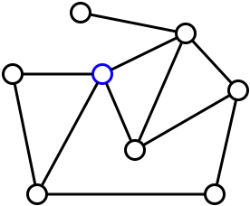
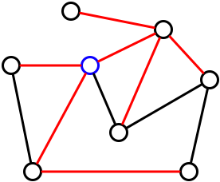
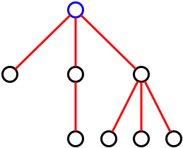
Example: Spanning Tree
Given an unweighted graph and a starting node, construct a spanning tree

Slide 6
Programming with Galois
Galois Iterators
Ordered and unordered foreach iterator
Galois Data Structures
Graphs, Sets, Maps, etc.

Slide 7
Programming with Galois
Algorithm
Choose v from worklist
For each neighbor u …
If u not in ST, add edge, mark u and add u to worklist
Data Structures
Graph
Spanning tree (set of edges)
Graph g = …
Node root = …
root.in = true
Worklist wl = {root}
Set st = { }
foreach v: wl
foreach u: v.neigh()
if not u.in
u.in = true
st.add((v, u))
wl.add(u)

Slide 8
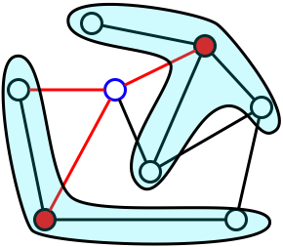
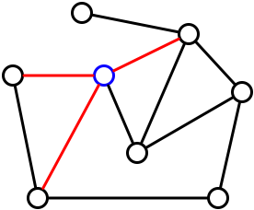
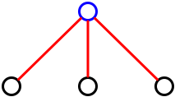
Where’s the Parallelism?
Active nodes are nodes on the frontier of ST
Neighborhood is immediate neighbors of active node
If neighborhoods are small, we can expand ST at several active nodes at once

Slide 9
How Much Parallelism is There?
If we assume an infinite number of processors?
and every activity takes unit time
and perfect knowledge of neighborhood and ordering constraints
How many steps would it take to finish?
How many activities can we execute in a step?

Slide 10
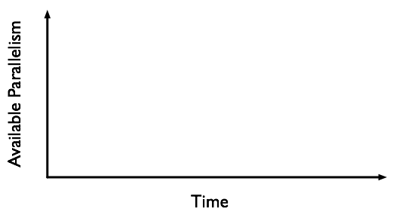
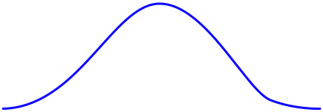
A Guess

Slide 11
Demo: Spanning Tree

Slide 12
How Does It Work?

Slide 13
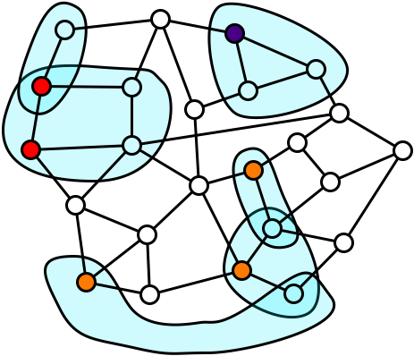
Simplified Measurement
Represent program as graph
No notion of ordering
Execution strategy
Choose independent sets of activities
Different choices → different profiles
parallelism
step
Conflict Graph

Slide 14
Greedy Scheduling
Finding schedule to maximize parallelism is NP-hard
Heuristic: schedule greedily
Attempt to maximize activities in current step
Choose maximal independent set in conflict graph

Slide 15
Measurement
Conflict graph changes during execution
New work generated
New conflicts
Solution: execute in stages, recalculate conflict graph after each stage
Conflict Graph

Slide 16
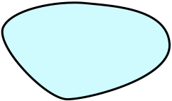
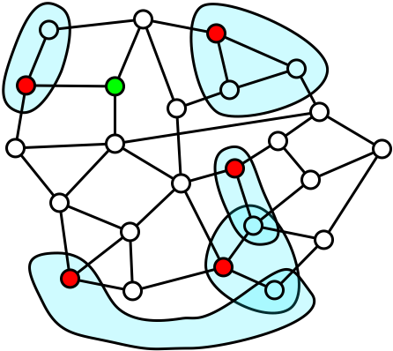
Incremental Execution
Conflict graph changes during execution
New work generated
New conflicts
Solution: execute in stages, recalculate conflict graph after each stage
Conflict Graph

Slide 17
ParaMeter Execution Strategy
While work left
Generate conflict graph for current worklist
Execute maximal independent set of nodes
Add newly generated work to worklist

Slide 18
Outline
Example: spanning tree
Demo of ParaMeter
Computing parallelism profiles
Algorithm classification

Slide 19
Spanning tree is a refinement morph
Typical profile
Little parallelism to start, as ST gets refined
Most parallelism in the middle, as more activities become independent
Little parallelism at the end, as algorithm runs out of work
Are there similar trends for other refinement algorithms?

Slide 20
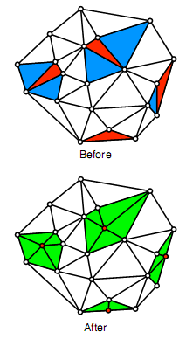
Delaunay Mesh Refinement
Active nodes: bad triangles
Neighborhoods: cavities
Refinement-like algorithm
As bad triangles get fixed, mesh gets larger
Cavity sizes stay roughly the same
As mesh grows, cavities less likely to overlap

Slide 21
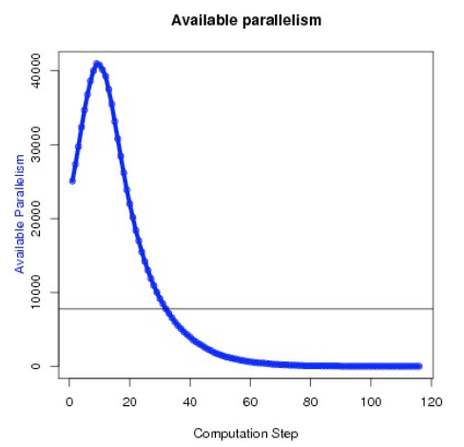
Refine 550K triangle mesh, initially 50% bad

Slide 22
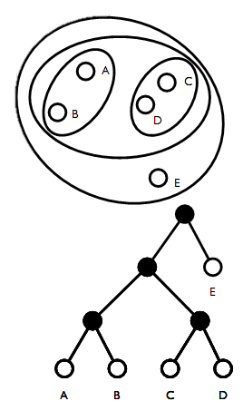
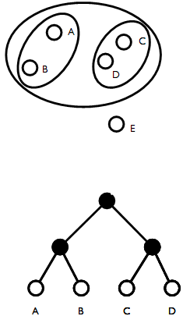
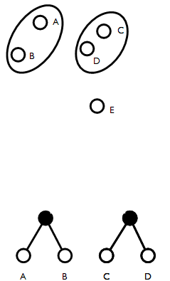
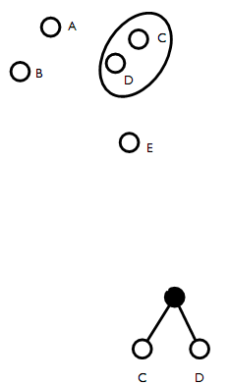
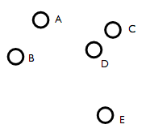
Agglomerative Clustering
Build a dendrogram by clustering points according to distance
Two points cluster if each is the other’s nearest neighbor
Dendrogram is built bottom-up

Slide 23
Agglomerative Clustering
Expect parallelism to match “bushiness” of dendrogram
Dendrogram built bottom-up
Coarsening morph
Parallelism should decrease as tree gets connected

Slide 24
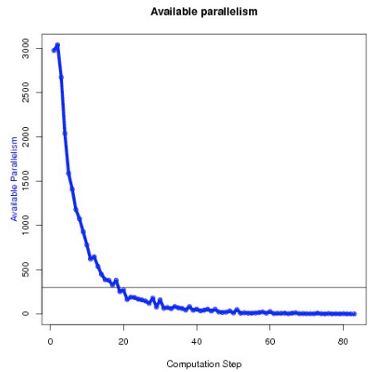
Cluster 100K randomly generated points

Slide 25
Kruskal’s Algorithm
3
Compute minimal spanning tree
Ordered algorithm
Active nodes must be processed in some order
Execute nodes like out-of-order processor
ParaMeter tracks when an activity executes not when it retires
5
1
3
4
2
6

Slide 26
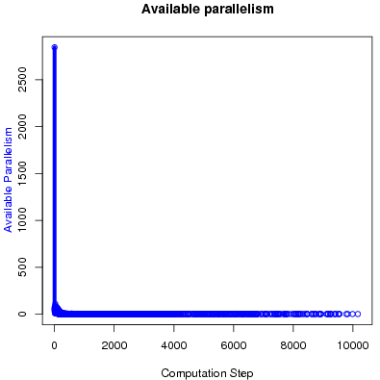
100x100 grid with random weights

Slide 27
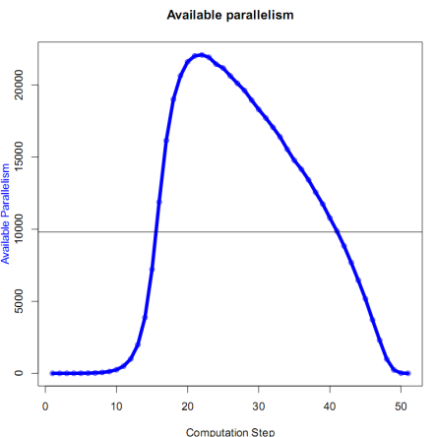
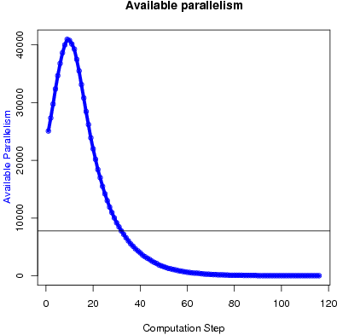
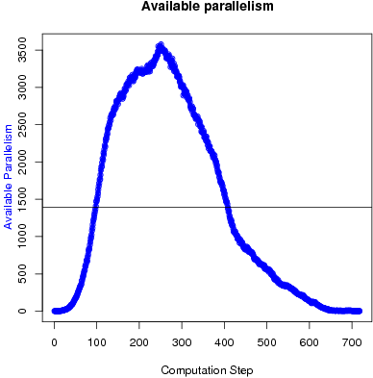
general graph
topology
grid
tree
refinement
morph
coarsening
general
topology-driven
operator
local computation
data-driven
reader
unordered
ordering
ordered
Spanning Tree
Delaunay Mesh Refinement
Delaunay Triangulation

Slide 28
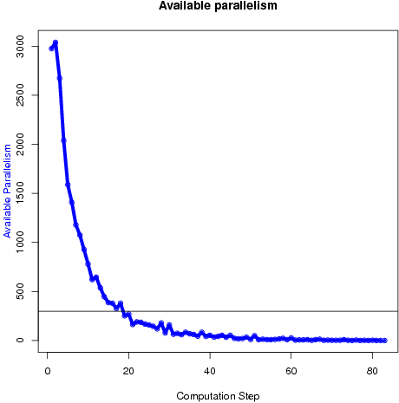
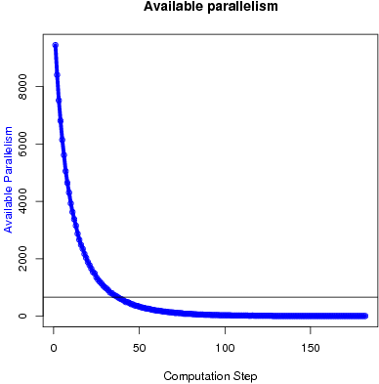
general graph
topology
grid
tree
refinement
morph
coarsening
general
topology-driven
operator
local computation
data-driven
reader
unordered
ordering
ordered
Agglomerative Clustering
Borvuka’s Algorithm

Slide 29
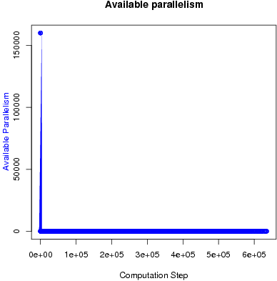
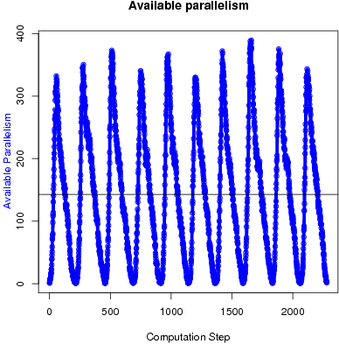
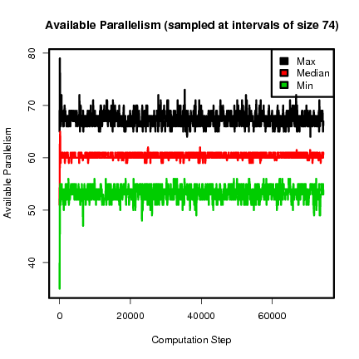
general graph
topology
grid
tree
refinement
morph
coarsening
general
topology-driven
Ordered vs. Unordered: a Comparison of Parallelism and Work-Efficiency in Irregular Algorithms,
M. Amber Hassaan, Martin Burtscher and Keshav Pingali
operator
local computation
data-driven
reader
unordered
ordering
ordered
Preflow-push
Single-source Shortest Path
Survey Propagation

Slide 30
Thanks
http://iss.ices.utexas.edu/galois

