Slide 1
The of Parallelism in Algorithms
Keshav Pingali
The University of Texas at Austin
Joint work with
D.Nguyen, M.Kulkarni, M.Burtscher, A.Hassaan, R.Kaleem, T-H. Lee, A.Lenharth, R.Manevich, M.Mendez-Lojo,D.Prountzos,X.Sui

Slide 2
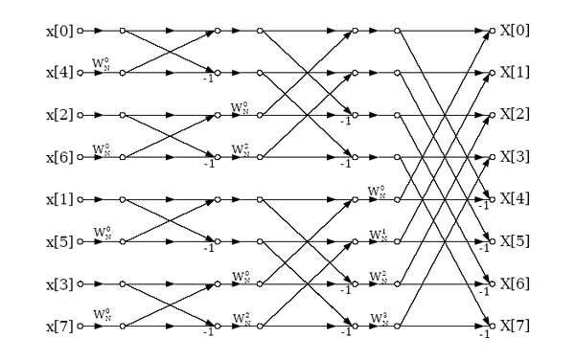
Message of paper
Parallel programming needs new foundations
dependence graphs are inadequate
cannot represent parallelism in irregular algorithms
New foundation:
operator formulation
data-centric abstraction
regular algorithms become special case
Key insights
amorphous data-parallelism (ADP) is ubiquitous
TAO analysis: structure in algorithms
use TAO structure to exploit ADP efficiently
Dependence graph for FFT

Slide 3
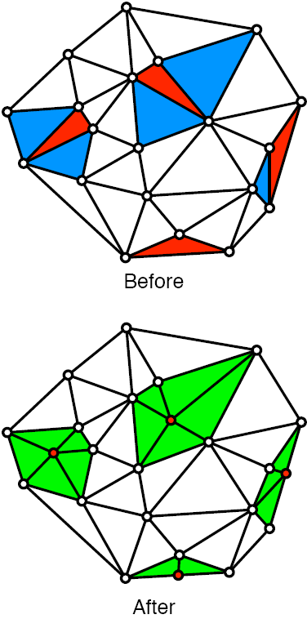
Inadequacy of static dependence graphs
Delaunay mesh refinement
Don’t-care non-determinism
final mesh depends on order in which bad triangles are processed
Data structure: graph
nodes: triangles
edges: triangle adjacencies
Parallelism
triangles with disjoint cavities can be processed in parallel
parallelism depends on runtime values
static dependence graph cannot be generated
parallelization must be done at runtime

Slide 4
Operator formulation of algorithms
Algorithm formulated in data-centric terms
active element:
node or edge where computation is needed
activity:
application of operator to active element
neighborhood:
set of nodes and edges read/written by activity
ordering:
order of execution of active elements in a sequential implementation
any order
problem-dependent order
Amorphous data-parallelism (ADP)
process active nodes in parallel, subject to neighborhood and ordering constraints
how do we exploit ADP?
: active node
: neighborhood

Slide 5
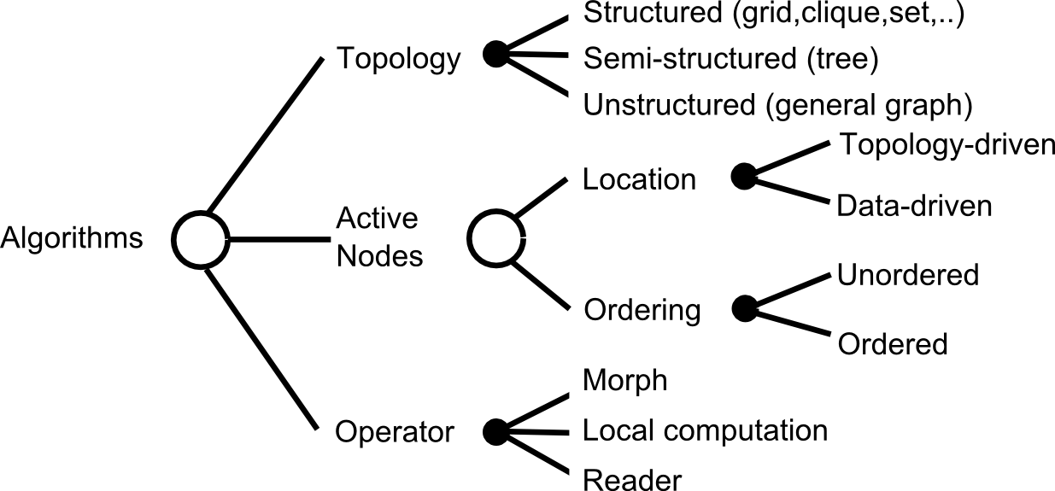
TAO analysis:structure in algorithms
: active node
: neighborhood
Cf: Parallel programming patterns (Snir,Intel), Berkeley motifs (Patterson)

Slide 6
Parallelization
When can you produce a parallel schedule for program?
Structured topology,
topology-driven algorithms
(dense linear algebra,FFT,finite-differences,..)
Compile-time
Static parallelization
3
After input is given
but before execution
Inspector-executor
2
During program
execution
4
Interference graph
1
After program
is finished
Optimistic
parallelization
Data-driven, ordered algorithms
(discrete-event simulation, Dijkstra SSSP,..)

Slide 7
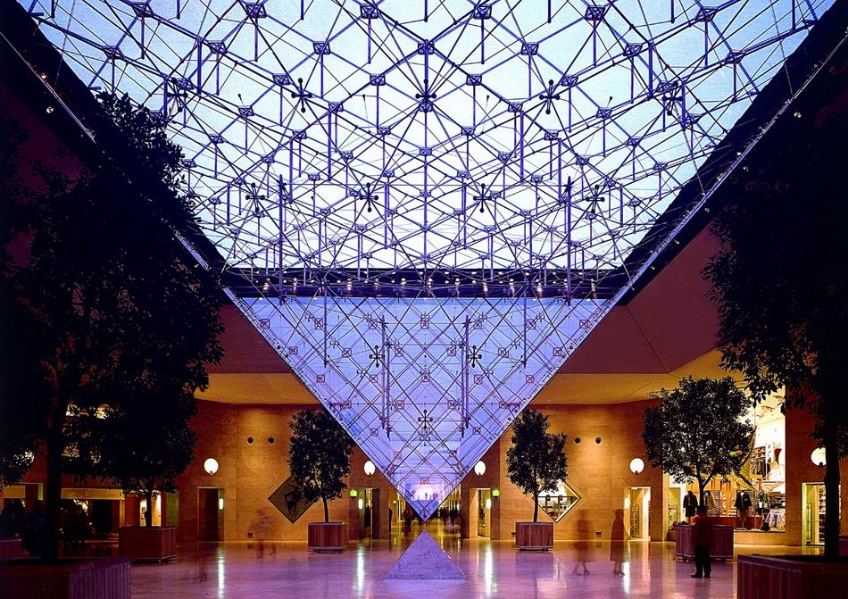
Galois system
Programming model:
Algorithms
sequential, OO language (Joe)
Java/C++ with Galois set iterators
Concurrent data structure library
expert programmers (Stephanie)
Execution model:
optimistic and static parallelization
Galois system (Java):
http://iss.ices.utexas.edu/galois

Slide 8
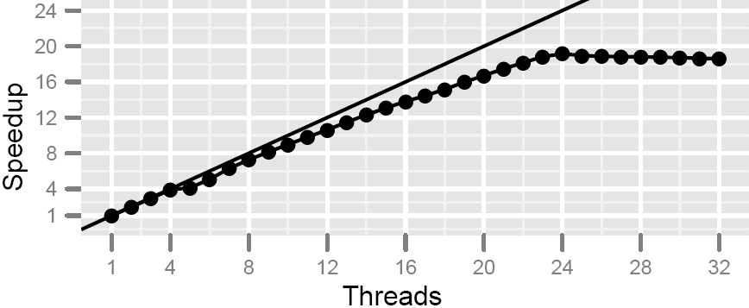
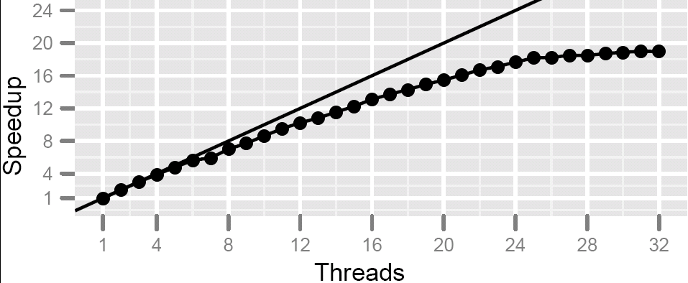
Performance
DMR: 500K triangles
Barnes-Hut
Machine: 4x6-core Intel Xeon X7540

Slide 9
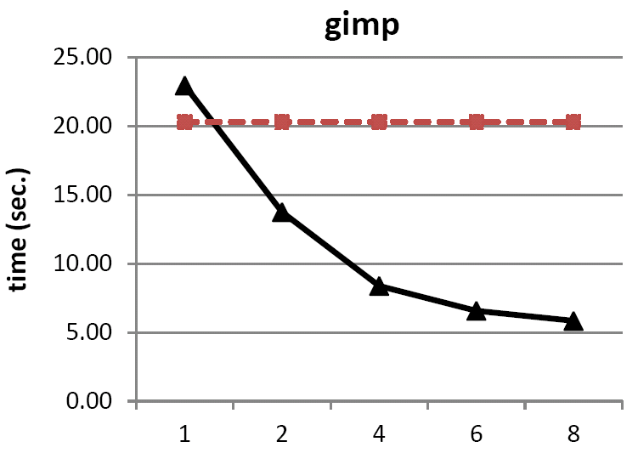
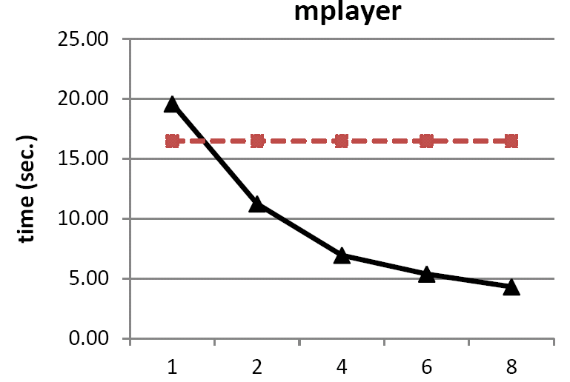
Andersen-style points-to analysis
Structural analysis
topology: general graph
operator: morph
ordering: unordered
Optimizations
cautious operator
lock optimization
Comparison
Hardekopf & Lin (PLDI 2007)
red lines in graphs
Mendez-Lojo et al (OOPSLA 2010)
Threads
Threads
Intel 8-core Xeon

Slide 10
Summary

