Slide 1
Galois System Tutorial
Mario Méndez-Lojo
Donald Nguyen

Slide 2
Writing Galois programs
Galois data structures
  choosing right implementation
  API
    basic
    flags (advanced)
Galois iterators
Scheduling
  assigning work to threads

Slide 3
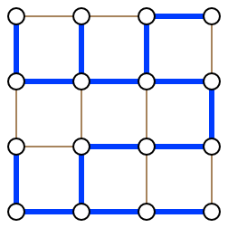
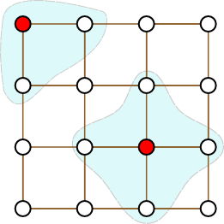
Motivating example – spanning tree
Compute the spanning tree of an undirected graph
Parallelism comes from independent edges
Release contains minimal spanning tree examples
  Borůvka, Prim, Kruskal

Slide 4
Spanning tree - pseudo code
create graph, initialize worklist and spanning tree
Graph graph = read graph from file
Node startNode = pick random node from graph
startNode.inSpanningTree = true
Worklist worklist = create worklist containing startNode
List result = create empty list
foreach src : worklist
foreach Node dst : src.neighbors
if not dst.inSpanningTree
dst.inSpanningTree = true
Edge edge= new Edge(src,dst)
result.add(edge)
worklist.add(dst)
worklist elements can be processed in any order
neighbor not processed?
add edge to solution
add to worklist

Slide 5
Outline
Serial algorithm
  Galois data structures
    choosing right implementation
    basic API
Galois (parallel) version
  Galois iterators
  scheduling
    assigning work to threads
Optimizations
  Galois data structures
    advanced API (flags)

Slide 6
Galois data structures
“Galoized” implementations
  concurrent
  transactional semantics
Also, serial implementations
galois.object package
  Graph
  GMap, GSet
  ...

Slide 7
Graph API
GNode<N>
<<interface>>
Graph<N>
setData(data: N)
getData()
createNode(data: N)
add(node: GNode)
remove(node: GNode)
addNeighbor(s: GNode, d: GNode)
removeNeighbor(s: GNode, d: GNode)
…
<<interface>>
Mappable<T>
map (closure: LambdaVoid<T>)
map(closure: Lambda2Void<T,E>)
…
<<interface>>
ObjectGraph<N,E>
addEdge(s: GNode, d: Gnode, data:E)
setEdgeData(s:GNode, d:Gnode, data:E)
…
ObjectMorphGraph
ObjectLocalComputationGraph

Slide 8
Mappable<T> interface
Implicit iteration over collections of type T
interface Mappable<T> {
void map(LambdaVoid<T> body); }
LambdaVoid = closure
interface LambdaVoid<T> {
void call(T arg);}
Graph and Gnode are Mappable
graph.map(LambdaVoid<T> body)
  “apply closure once per node in graph”
node.map(LambdaVoid<T> body)
  “apply closure once per neighbor of this node”

Slide 9
Spanning tree - serial code
has the node been processed?
graphs created using builder pattern
Graph<NodeData> graph=new MorphGraph.GraphBuilder().create()
GNode startNode = Graphs.getRandom(graph)
startNode.inSpanningTree = true
Stack<GNode> worklist = new Stack(startNode);
List<Edge> result = new ArrayList()
while !worklist.isEmpty()
src = worklist.pop()
src.map(new LambdaVoid(){
void call(GNode<NodeData> dst) {
NodeData dstData = dst.getData();
if !dstData.inSpanningTree
dstData.inSpanningTree = true
result.add(new Edge(src, dst))
worklist.add(dst)
}})
graph utilities
LIFO scheduling
for every neighbor of the active node

Slide 10
Outline
Serial algorithm
  Galois data structures
    choosing right implementation
    basic API
Galois (parallel) version
  Galois iterators
  scheduling
    assigning work to threads
Optimizations
  Galois data structures
    advanced API (flags)

Slide 11
Galois iterators
unordered iterator
initial worklist
static <T> void GaloisRuntime.foreach(Iterable<T> initial,
Lambda2Void<T, ForeachContext<T>> body,
Rule schedule)
GaloisRuntime
  ordered iterators, runtime statistics, etc
Upon foreach invocation
  threads are spawned
  transactional semantics guarantee
    conflicts, rollbacks
    transparent to the user
apply closure to each active element
scheduling policy

Slide 12
Scheduling
scheduling → implementation
  synthesis algorithm
  check Donald’s paper in ASPLOS’11
Good scheduling → better performance
Available schedules
  FIFO, LIFO, random, chunkedFIFO/LIFO/random, etc.
  can be composed
Usage
GaloisRuntime.foreach(initialWorklist , new ForeachBody() {
void call(GNode src, ForeachContext context) {
src.map(src, new LambdaVoid(){
void call(GNode<NodeData> dst) {
…
context.add(dst)
}}}}, Priority.first(ChunkedFIFO.class))
new active elements are added through context
use this scheduling strategy

Slide 13
Spanning tree - Galois code
ArrayList replaced by Galois multiset
Graph<NodeData> graph = builder.create()
GNode startNode = Graphs.getRandom(graph)
startNode.inSpanningTree = true
Bag<Edge> result = Bag.create()
Iterable<GNode> initialWorklist = Arrays.asList(startNode)
GaloisRuntime.foreach(initialWorklist , new ForeachBody() {
void call(GNode src, ForeachContext context) {
src.map(src, new LambdaVoid(){
void call(GNode<NodeData> dst) {
dstData = dst.getData()
if !dstData.inSpanningTree
dstData.inSpanningTree = true
result.add(new Pair(src, dst))
context.add(dst)
}}}}, Priority.defaultOrder())
gets element from worklist + applies closure (operator)
worklist facade

Slide 14
Outline
Serial algorithm
  Galois data structures
    choosing right implementation
    basic API
Galois (parallel) version
  Galois iterators
  scheduling
    assigning work to threads
Optimizations
  Galois data structures
    advanced API (flags)

Slide 15
Optimizations - “flagged” methods
Speculation overheads associated with invocations on Galois objects
  conflict detection
  undo actions
Flagged version of Galois methods→ extra parameter
N getNodeData(GNode src)
N getNodeData(GNode src, byte flags)
Change runtime default behavior
  deactivate conflict detection, undo actions, or both
  better performance
  might violate transactional semantics

Slide 16
Spanning tree - Galois code
GaloisRuntime.foreach(initialWorklist , new ForeachBody() {
void call(GNode src, ForeachContext context) {
src.map(src, new LambdaVoid(){
void call(GNode<NodeData> dst) {
dstData = dst.getData(MethodFlag.ALL)
if !dstData.inSpanningTree
dstData.inSpanningTree = true
result.add(new Pair(src, dst), MethodFlag.ALL)
context.add(dst, MethodFlag.ALL)
}
}, MethodFlag.ALL)
}
}, Priority.defaultOrder())
acquire abstract locks + store undo actions

Slide 17
Spanning tree - Galois code (final version)
GaloisRuntime.foreach(initialWorklist , new ForeachBody() {
void call(GNode src, ForeachContext context) {
src.map(src, new LambdaVoid(){
void call(GNode<NodeData> dst) {
dstData = dst.getData(MethodFlag.NONE)
if !dstData.inSpanningTree
dstData.inSpanningTree = true
result.add(new Pair(src, dst), MethodFlag.NONE)
context.add(dst, MethodFlag.NONE)
}
}, MethodFlag.CHECK_CONFLICT)
}
}, Priority.defaultOrder())
Flags can be inferred automatically!
  static analysis [D. Prountzos et al., POPL 2011]
  without loss of precision
  …not included in this release
we already have lock on dst
nothing to lock + cannot be aborted
nothing to lock + cannot be aborted
acquire lock on src and neighbors

Slide 18
Galois roadmap
write serial irregular app, use Galois objects
foreach instead of loop, default flags
correct parallel execution?
NO
adjust flags
YES
efficient parallel execution?
NO
change scheduling
YES
consider alternative data structures

Slide 19
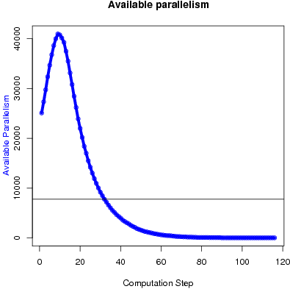
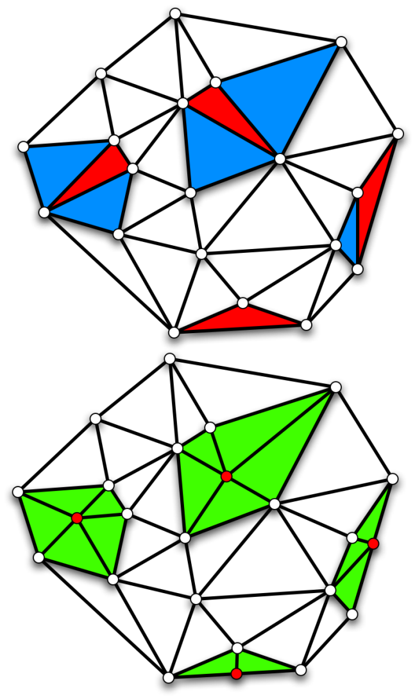
Experiments
Xeon machine, 8 cores
Delaunay Refinement
  refine triangles in a mesh
Results
  input: 500K triangles
    half “bad”
  little work available by the end of refinement
  “chunked FIFO, then LIFO” scheduling
  speedup: 5x

Slide 20
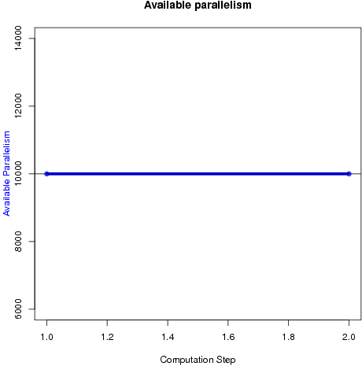
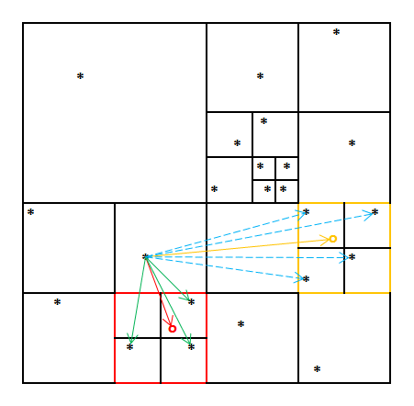
Experiments
Xeon machine, 8 cores
Barnes Hut
  n-body simulation
Results
  input: 1M bodies
  embarrassingly parallel
    flag = NONE
  low overheads!
  comparable to hand-tuned SPLASH implementation
  speedup: 7x
Notes:
CHANGE PARAMETER PROFILE!!!!!

Slide 21
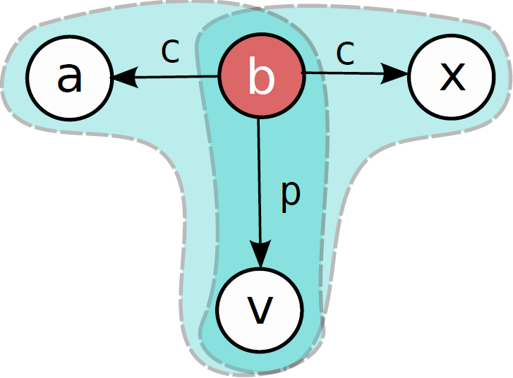
Experiments
Xeon machine, 8 cores
Points-to Analysis
  infer variables pointed by pointers in program
Results
  input: linux kernel
  seq. implementation in C++
  “chunked FIFO” scheduling
  seq. phases limit speedup
  speedup: 3.75x

Slide 22
Irregular applications included
Lonestar suite: algorithms already described plus…
  minimal spanning tree
    Borůvka, Prim, Kruskal
  maximum flow
    Preflow push
  mesh generation
    Delaunay
  graph partitioning
    Metis
  SAT solver
    Survey propagation
Check the apps directory for more examples!

Slide 23
Thank you for attending this tutorial!
Questions?
download Galois at
http://iss.ices.utexas.edu/galois/

Slide 24
Scheduling (II)
Order hierarchy
  apply 1st rule, in case of tie use 2nd and so on
  Priority.first(ChunkedFIFO.class).then(LIFO.class).then(…)
Local order
  apply….
Priority.first(ChunkedFIFO.class).thenLocally(LIFO.class));
Strict order
  ordered + comparator
  Priority.first(Ordered.class, new Comparator(){
  int compare(Object o1, Object o2) {…}
  });

