Slide 1
A GPU Implementation of Inclusion-based Points-to Analysis
Mario Méndez-Lojo (AMD)
Martin Burtscher (Texas State University, USA)
Keshav Pingali (U.T. Austin, USA)

Slide 2
GPU + irregular algorithms
Regular algorithms
manipulate matrices
GPU + regular algorithm = OK
MMM, sorting, …
Irregular algorithms
manipulate graphs
local computation: modifies edge/node values, not graph structure
BFS, SCC, BH, …
GPU + local computation algorithm = OK
refinement: adds edges or nodes
GPU + refinement algorithm = ?
Goal: implement refinement algorithm on GPU
Andersen’s points-to analysis

Slide 3
Overview
Andersen’s points-to analysis
graph formulation
parallelization
GPU implementation
graph representation
rule application
optimizations
Experiments
vs. serial CPU code
vs. parallel CPU code

Slide 4
Points-to analysis
Static analysis technique
approximate locations pointed to by (pointer) variable
useful for code optimization, verification…
Focus: Andersen’s analysis
available in modern compilers (gcc, LLVM…)
context and flow insensitive

Slide 5
Andersen’s - graph formulation [OOPSLA’10]
Extract pointer assignments
x= &y, x=y, x=*y, *x=y, x=y+o
Create initial constraint graph
nodes ≡ variables, edges ≡ statements
Apply graph rewrite rules until fixpoint (next slide)
solution = points-to subgraph
C code | name | edge
x = &y | points
x = y | copy
x= ∗y | load
*x = y | store
x=y+o | addPtr

Slide 6
Graph rewrite rules
NAME | REWRITE RULE | ENSURES
copy
c
c
x
y
x
y
p
p
p
z
z
Program
y=&t;
x=&r
x=y;
y=&s;
c
c
c
x
y
x
y
x
y
p
r
p
r
p
r
p
p
p
p
p
s
s
s
t
p
t
p
p
p
t

Slide 7
Graph rewrite rules
NAME | RULE | ENSURES
copy
c
x
y
p
p
z
l
load
x
y
c
p
z
p
store
addPtr
x
y
c
s
z
a,o
x
y
p
p
z+o
z

Slide 8
Parallelization
All rules can proceed in parallel
Requires atomic edge additions
enforced by data structure
c
c
s
x
y
p
p
p
p
t
z

Slide 9
GPU - graph representation
Cannot use standard representations
space → adjacency matrix
dynamic addition of edges → CSR
Sparse bit vector
linked list
base indicates range
bits indicates membership
Example (bits width = 8)
represents {0*8+0, 0*8+2, 1*8 + 7} = {0,2,15}

Slide 10
Sparse bit vectors on the GPU
Node is 128 bytes-wide
Good fit for Fermi architecture
assign i^{th} word to i^{th} thread of warp
load node from global/shared memory = 1 transaction
thread i brings in i^{th} word
set operations cause little thread divergence
thread i=0..30 operates on i^{th} word, thread 31 skips

Slide 11
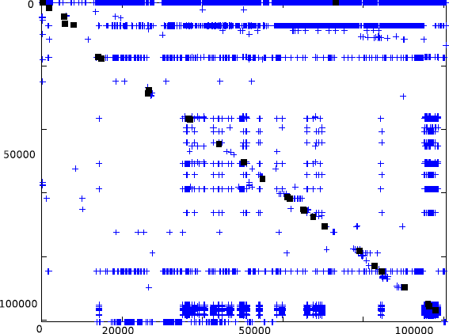
Wide sparse bit vectors
Bits mostly empty → waste of space and parallelism
Works well in practice because of data locality
identifiers sequentially assigned to variables in program order
if x points to y, x probably points to variables with identifiers close to y
Adjacency matrix for P edges
input = gcc, #vars=120K
initial graph in black, final in blue

Slide 12
Rule execution on the GPU
Concurrent rule execution requires synchronization
GPUs support atomics, but hurts performance
Solution: flip edges
Active nodes add edges to themselves
no synchronization required
each active node processed by only one thread
c
c
r
x
y
p
p
p
p
s
z
r
c⁻¹
c⁻¹
x
y
p
p
p
p
s
z

Slide 13
Reversed rules
 | original | reversed
copy
load
store
ptrAdd
c
c⁻¹
x
y
x
y
p
p
p
p
z
z
l
l⁻¹
x
y
x
y
c
p
c⁻¹
p
z
z
p
p⁻¹
x
y
x
y
c
s
c⁻¹
s
z
z
a,o
a⁻¹,o
x
y
x
y
p
p
p
p
z+o
z
z+o
z

Slide 14
Baseline algorithm
read input
transfer program statements to GPU
create initial constraint graph
yes
apply rewrite rules
graph changed?
no
transfer P subgraph to CPU
verify solution
blue=CPU, red=GPU, green=transfer

Slide 15
Iterations perform redundant work
Solution: keep two sets of points-to edges
∆P: added in last iteration
P: added before last iteration
Implies
replace P by ∆P in rules
when iteration ends, update P and ∆P
c⁻¹
x
y
p
p
node x should fire this rule only once!
z

Slide 16
Optimized algorithm
read input
transfer program statements to GPU
create initial constraint graph
yes
transfer ∆P subgraph
to CPU
apply rewrite rules
graph changed?
no
update ∆P
verify solution
+
=
transfer
penalty
blue=CPU, red= GPU, green=transfer
transfer time < rule time
small transfer (<10ms)

Slide 17
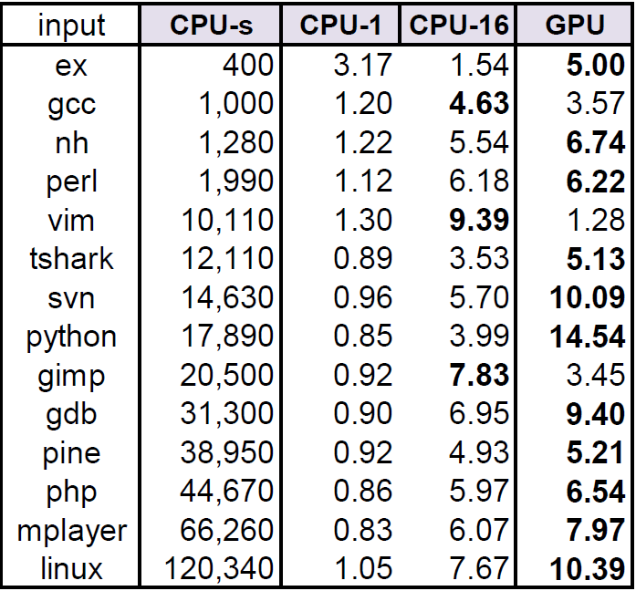
Results
Input: large C programs
linux: 1.5M vars, 420K statements
CPU-s
AMD Opteron, 16 cores @ 2.7Ghz
C++, sequential
“The ant and the grasshopper…” [PLDI’07]
CPU-1 and CPU-16
Same HW as CPU-s
Java 1.6, parallel
“Parallel inclusion-based points-to analysis” [OOPSLA’10]
GPU
NVIDIA Tesla C2070, 14 SMs @ 1.15Ghz
CUDA 4.1
GPU beats CPU-16 for 11/14 inputs
avg speedup: 7x (compared to CPU-s)
time (ms) speedup speedup

Slide 18
GPU + irregular algorithm = OK
Success story: Andersen’s points-to analysis
7x speedup compared to CPU-sequential
40% faster than CPU-parallel
Rethink data structures + algorithm
CPU-parallel similar to CPU-sequential
GPU very different to both
GPU took 35% more person hours (vs. CPU-parallel)
In the paper
dynamic work assignment
memory allocation
experimental analysis

Slide 19
Thank you!
CPU (parallel) + GPU implementations
available at
http://cliplab.org/~mario

