Slide 1
Parallel Inclusion-based Points-to Analysis
Mario Méndez-Lojo Augustine Mathew Keshav Pingali
The University of Texas at Austin (USA)

Slide 2
Points-to analysis
Static analysis technique
approximate locations pointed by (pointer) variable
useful for optimization, verification…
Dimensions
flow sensitivity
What is the set of locations pointed by x?
x=&a; x=&b;
flow sensitive: {b}, flow insensitive: {a,b}
context sensitivity
Focus: context insensitive + flow insensitive solutions
inclusion-based, not unification-based
available in modern compilers (gcc, LLVM…)

Slide 3
Inclusion-based points-to analysis
First proposed by Andersen [Andersen thesis’94]
Much research focused on performance improvements
heuristics for cycle detection [Fahndrich PLDI’98; Hardekopf PLDI’07]
offline preprocessing [Rountev PLDI’00]
better ordering [Magno CGO’09]
BDD-based representation [Lhotak PLDI’04]
…
What about parallelization?
“future work” [Khalon PLDI’07, Magno CGO’09,….]
never done before

Slide 4
Parallel inclusion-based points-to analysis
Challenges
highly irregular code
BDD, sparse bit vectors, etc
some phases of the algorithms are difficult to parallelize
SCC detection/DFS
Contributions
novel graph formulation
parallelization of Andersen’s algorithm
exploits algorithmic structure
up to 5x speedup vs. Hardekopf & Lin’s state-of-the-art implementation [PLDI’07]

Slide 5
Agenda
inclusion-based points-to analysis
graph formulation
parallel inclusion-based points-to analysis
efficient parallelization
parallelization
of irregular algorithms
Parallelization of graph (irregular) algorithms

Slide 6
Agenda
inclusion-based points-to analysis
graph formulation
parallel inclusion-based points-to analysis
efficient parallelization
parallelization
of irregular algorithms

Slide 7
Andersen’s algorithm for C programs
Extract pointer assignments
a= &b, a=b, a=*b, *a=b
Transform statements into set constraints
Iteratively solve system of constraints
C code | name | constraint
a = &b | address of | pts(a) ⊇ {b}
a = b | copy | pts(a) ⊇ pts(b)
a = ∗b | load | ∀v ∈ pts(b) : pts(a) ⊇ pts(v)
*a = b | store | ∀v ∈ pts(a) : pts(v) ⊇ pts(b)

Slide 8
Example
program
a=&v;
*a=b;
b=x;
x=&w;

Slide 9
Example
program
a=&v;
*a=b;
b=x;
x=&w;
constraints
pts
a | {}
b | {}
v | {}
w | {}
x | {}

Slide 10
Example
program
a=&v;
*a=b;
b=x;
x=&w;
constraints
pts
a | {v}
b | {w}
v | {w}
w | {}
x | {w}

Slide 11
Constraint representation shortcomings
Difficult reasoning about algorithm
separate representation
constraints
points-to sets
in parallel
which constraints can be processed simultaneously?
which points-to can be modified simultaneously?
Cycle collapsing complicates things
representative table
Need simpler representation

Slide 12
Proposed graph representation
Extract pointer assignments
a= &b, a=b, a=*b, *a=b
Create initial constraint graph
nodes ≡ variables
edges ≡ statements
Apply graph rewrite rules until fixpoint (next slide)
C code | name | edge
a = &b | address of
a = b | copy
a = ∗b | load
*a = b | store

Slide 13
Graph rewrite rules
name | rule | ensures
copy

Slide 14
Graph rewrite rules
Example:
name | rule | ensures
copy
program
b=&v;
a=&x
a=b;
b=&w;

Slide 15
Graph rewrite rules
name | rule | ensures
copy
load
store

Slide 16
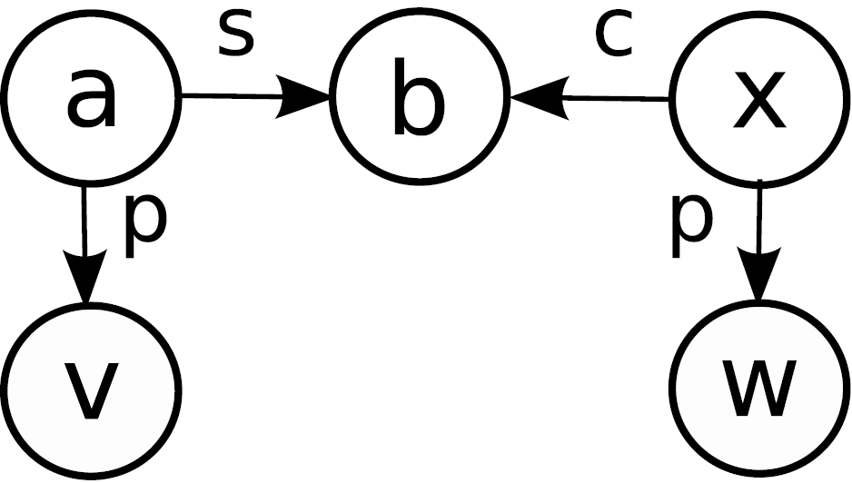
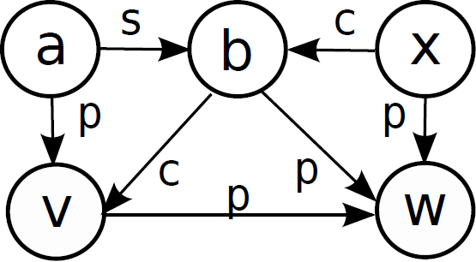
Example revisited
constraints
pts
a | {}
b | {}
v | {}
w | {}
x | {}
pts
a | {v}
b | {w}
v | {w}
w | {}
x | {w}
program
a=&v;
*a=b;
b=x;
x=&w;
solve
init
init
solve

Slide 17
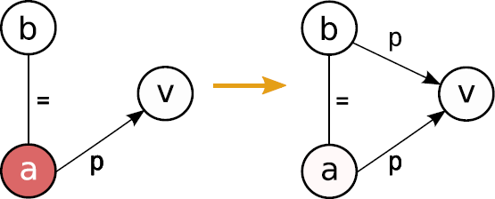
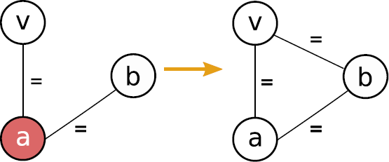
Advantages of graph formulation
Solving process entirely expressed as graph rewriting
Merging can be easily incorporated
equivalent edge
new rules
Leverage existing techniques for parallelizing graph algorithms [next few slides]
push
equivalent

Slide 18
Agenda
inclusion-based points-to analysis
graph formulation
parallel inclusion-based points-to analysis
efficient parallelization
parallelization
of irregular algorithms

Slide 19
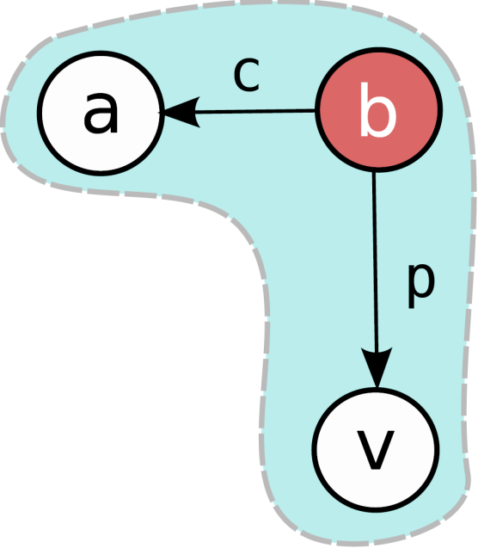
Graph algorithms – Galois approach
Active node
node where computation is needed
Andersen: node violating a rule’s invariant
Activity
application of certain code to active node
Andersen: rewrite rule
Neighborhood
set of nodes/edges read/written by activity
Andersen: 3 nodes involved in rule

Slide 20
Parallelization of graph algorithms

Slide 21
Parallelization of graph algorithms

Slide 22
Parallelization of graph algorithms
Correct parallel execution
neighborhoods do not overlap → activities can be executed in parallel
baseline conflict detection policy
Implementation
use speculation
each node has an associated exclusive abstract lock
graph operations → acquire locks on read/written nodes
lock already owned → conflict → activity rolled back

Slide 23
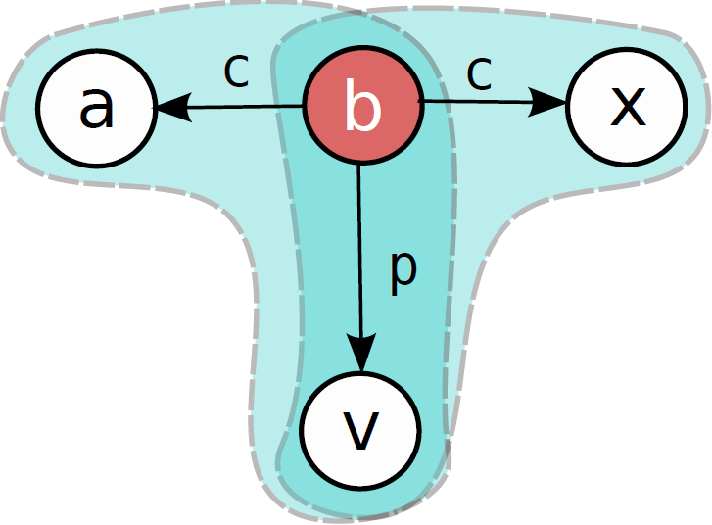
Parallelizing Andersen’s algorithm
Baseline conflict detection
activity acquires 3 locks, processes rule
conflict when rules sharing nodes are processed simultaneously
Correct but too restrictive
activity 1 adds p-edge <a,v>
activity 2 adds p-edge <x,v>

Slide 24
Optimal conflict detection
Avoid abstract locks on read nodes
edges never removed from graph
activity 1 adds p-edge <a,v>
activity 2 adds p-edge <x,v>

Slide 25
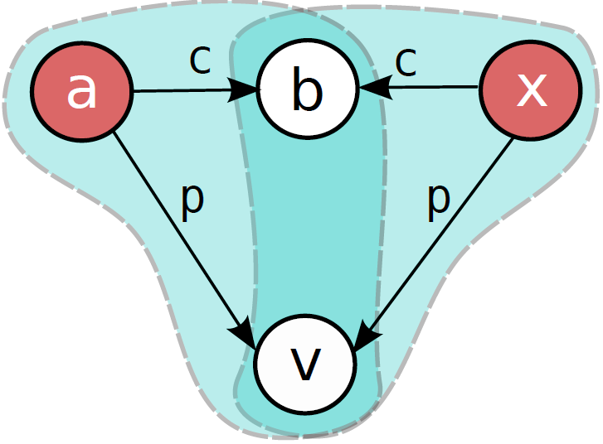
Optimal conflict detection
Avoid abstract locks on read nodes
edges never removed from graph
Avoid abstract locks on written nodes
edge additions commute with each other
concrete implementation guarantees consistency
Conflicts → abstract locks→ rollbacks
speculation not necessary!
activity 1 adds p-edge <b,v>
activity 2 adds p-edge <b,v>

Slide 26
Implementation
Implemented in Galois system [Kulkarni PLDI’07]
graph implementations, scheduling policies, etc.
conflict detection turned off → speculation overheads
Key data structures
Binary Decision Diagram
points-to edges
lock-based hash set
sparse bit vector
copy/store/load edges
lock-free linked list
Download at http://www.ices.utexas.edu/~marioml

Slide 27
Results: runtimes
Intel Xeon machine, 8 cores
(our) sequential vs parallel
whole analysis
JVM 1.6, 64 bits, Linux 2.6.30
Input: suite of C programs
gcc: 120K vars, 156K stmts
tshark: 1500K vars, 1700K stmts
Low parallelization overheads
not more than 30%
Good scalability
↑cores → ↓runtime

Slide 28
Results: speedups
Reference (sequential) analysis
Hardekopf & Lin [PLDI’07, SAS’07]
written in C++
state-of-the-art, publicly available implementation
Xeon machine, 8 cores
reference: phase within LLVM 2.6
parallel: standalone, JVM 1.6
Speedup wrt C++ version
whole analysis
2-5x
can be > 1 with 1 thread (tshark)
Sequential phases limit speedup
SCC detection, BDD init, etc.
≈150K vars, 150K stms
seq: 7% (1 thread)
seq: 26% (8 threads)
≈150K vars, 150K stms
seq: 9% (1 thread)
seq: 32% (8 threads)

Slide 29
Conclusions
Inclusion-based points-to analysis
widely used technique
Contributions
Novel graph representation
First parallelization of a points-to algorithm
correctness: exploit graph abstraction
efficiency: exploit algorithm structure
Good results
2-5x speedup wrt to state-of-the-art

Slide 30
Thank you!
implementation + slides available at
http://www.ices.utexas.edu/~marioml

